Slide 1
MANOVA - Equations
Lecture 11
Psy524
Andrew Ainsworth

Slide 2
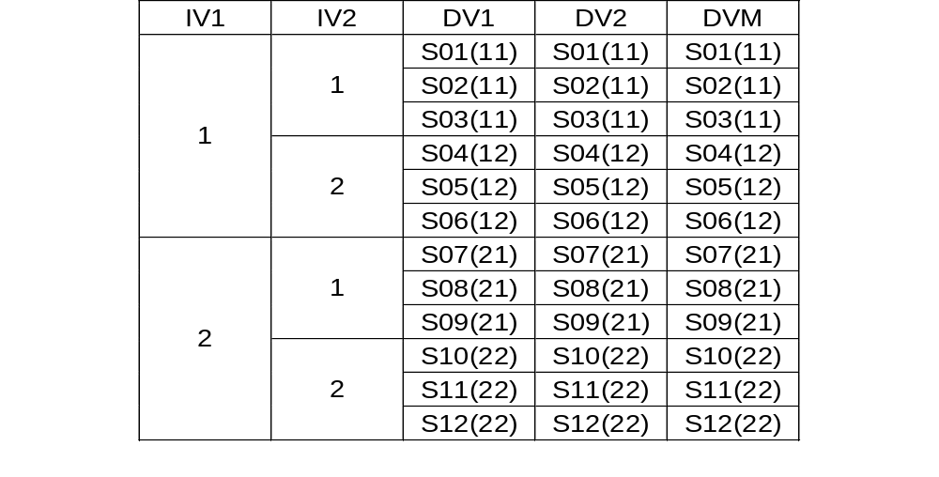
Data design for MANOVA

Slide 3
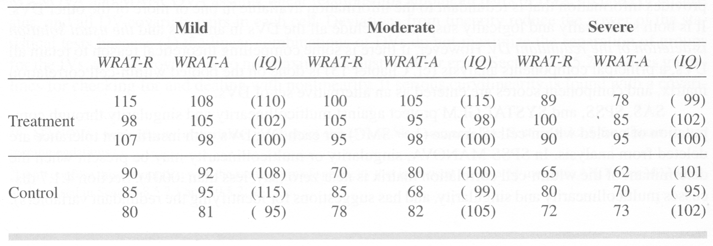
Data design for MANOVA

Slide 4
Steps to MANOVA
MANOVA is a multivariate generalization of ANOVA, so there are analogous parts to the simpler ANOVA equations

Slide 5
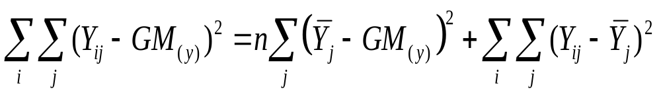
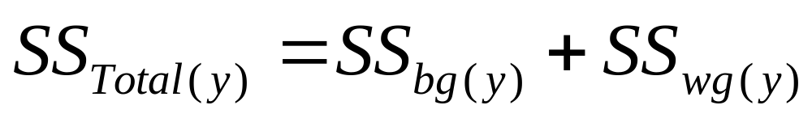
Steps to MANOVA
ANOVA –

Slide 6
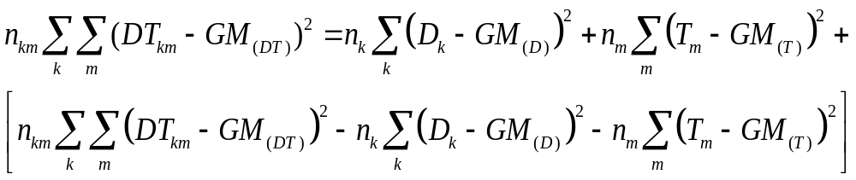
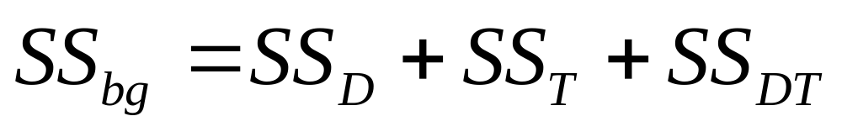
Steps to MANOVA
When you have more than one IV the interaction looks something like this:

Slide 7
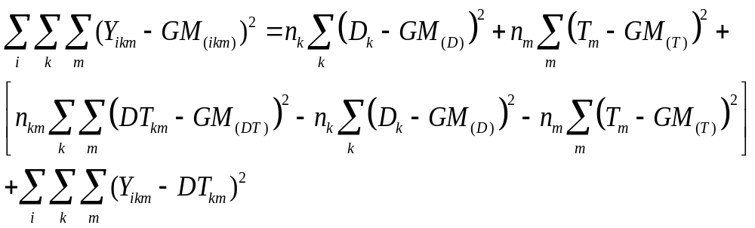
Steps to MANOVA
The full factorial design is:

Slide 8
Steps to MANOVA
MANOVA - You need to think in terms of matrices
  Each subject now has multiple scores, there is a matrix of responses in each cell
  Matrices of difference scores are calculated and the matrix squared
  When the squared differences are summed you get a sum-of-squares-and-cross-products-matrix (S) which is the matrix counterpart to the sums of squares.
  The determinants of the various S matrices are found and ratios between them are used to test hypotheses about the effects of the IVs on linear combination(s) of the DVs
  In MANCOVA the S matrices are adjusted for by one or more covariates

Slide 9
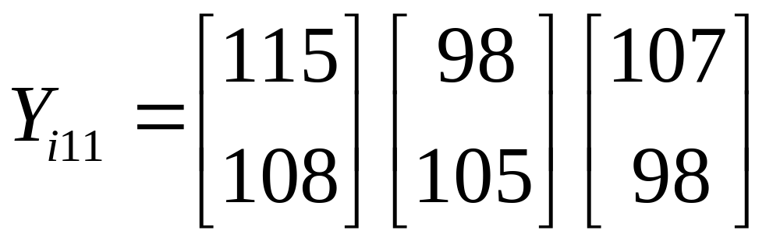
Matrix Equations
If you take the three subjects in the treatment/mild disability cell:

Slide 10
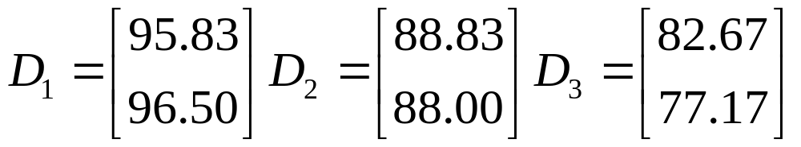
Matrix Equations
You can get the means for disability by averaging over subjects and treatments

Slide 11
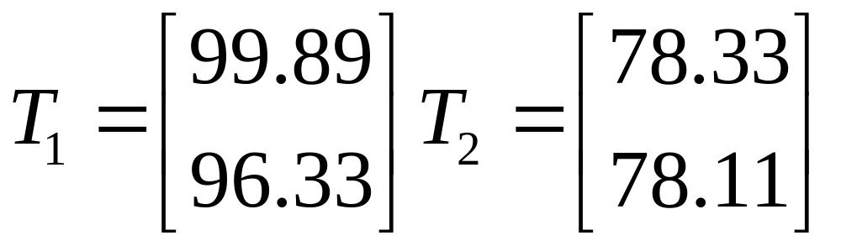
Matrix Equations
Means for treatment by averaging over subjects and disabilities

Slide 12
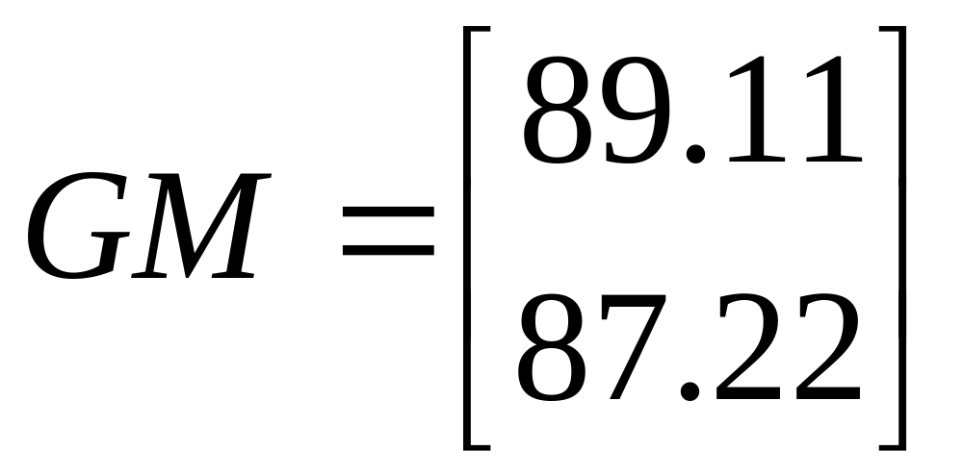
Matrix Equations
The grand mean is found by averaging over subjects, disabilities and treatments.

Slide 13
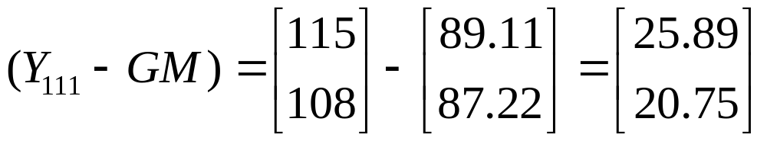
Matrix Equations
Differences are found by subtracting the matrices, for the first child in the mild/treatment group:

Slide 14
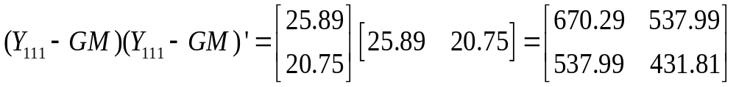
Matrix Equations
Instead of squaring the matrices you simply multiply the matrix by its transpose, for the first child in the mild/treatment group:

Slide 15
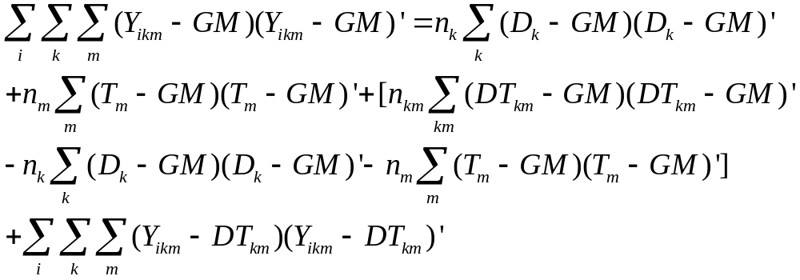
Matrix Equations
This is done on the whole data set at the same time, reorganaizing the data to get the appropriate S matrices. The full break of sums of squares is:

Slide 16
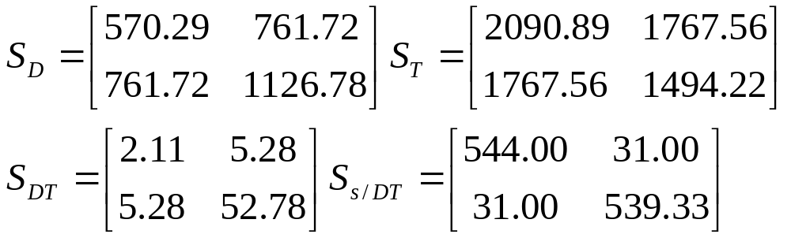
Matrix Equations
If you go through this for every combination in the data you will get four S matrices (not including the S total matrix):

Slide 17
Test Statistic – Wilk’s Lambda
Once the S matrices are found the diagonals represent the sums of squares and the off diagonals are the cross products
The determinant of each matrix represents the generalized variance for that matrix
Using the determinants we can test for significance, there are many ways to this and one of the most is Wilk’s Lambda

Slide 18
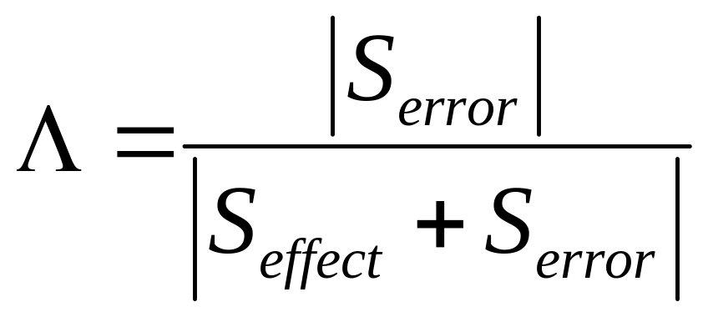
Test Statistic – Wilk’s Lambda
this can be seen as the percent of non-overlap between the effect and the DVs.

Slide 19
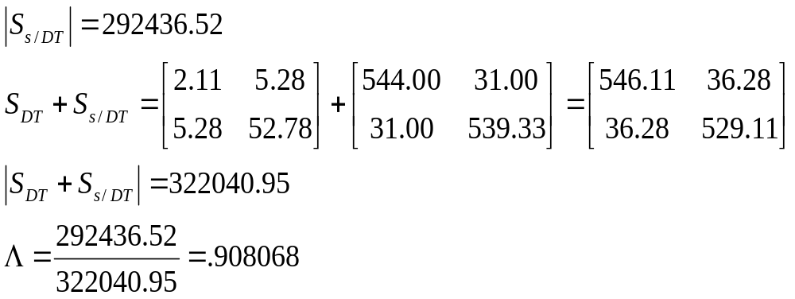
Test Statistic – Wilk’s Lambda
For the interaction this would be:

Slide 20
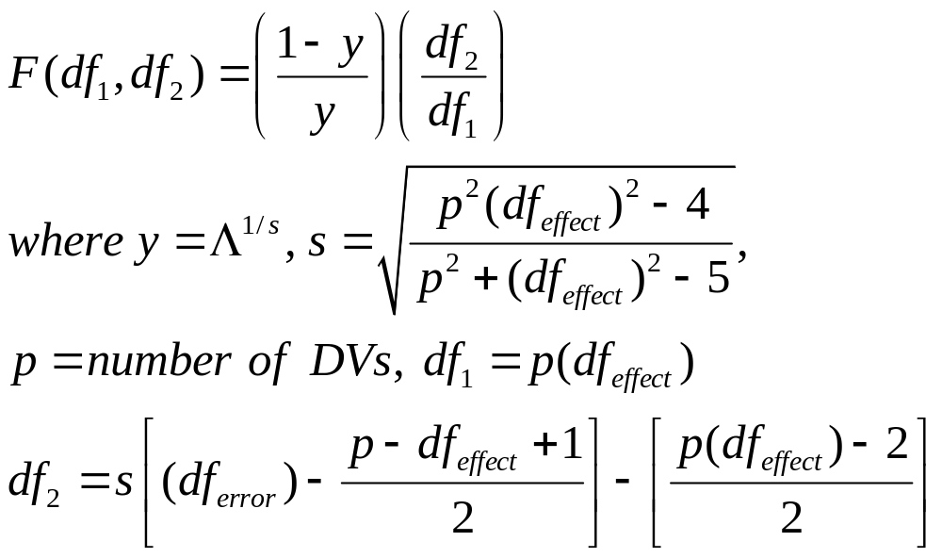
Test Statistic – Wilk’s Lambda
Approximate Multivariate F for Wilk’s Lambda is

Slide 21
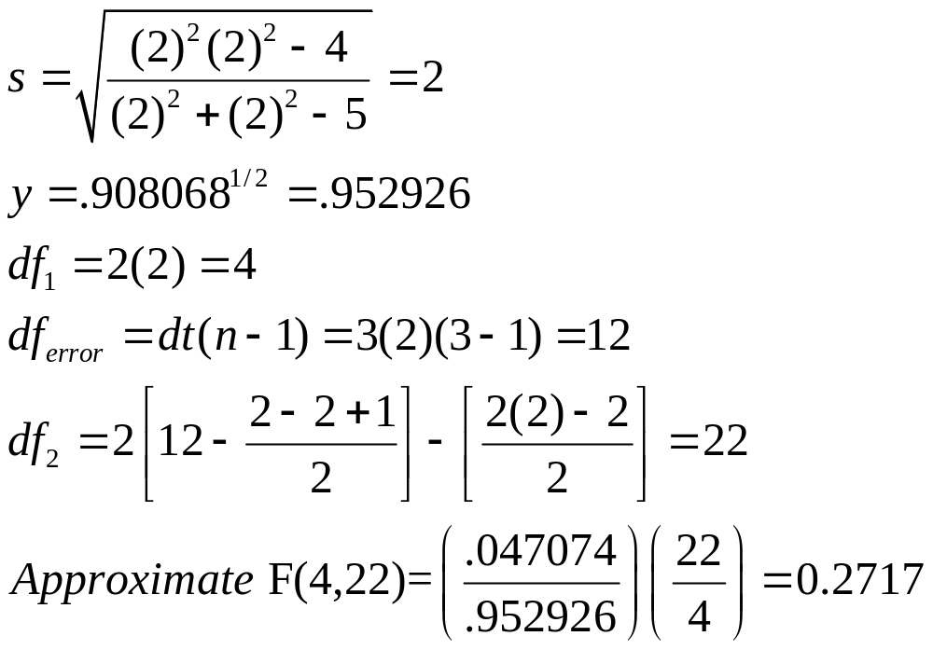
Test Statistic – Wilk’s Lambda
So in the example for the interaction:

Slide 22
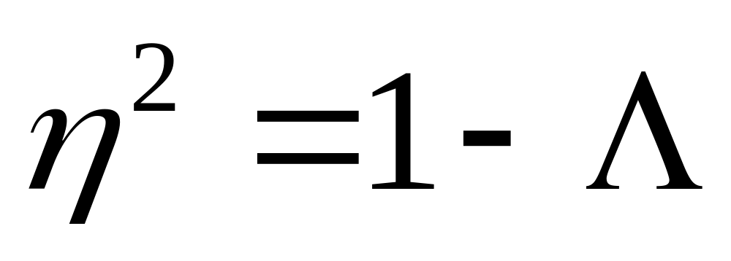
Eta Squared

Slide 23
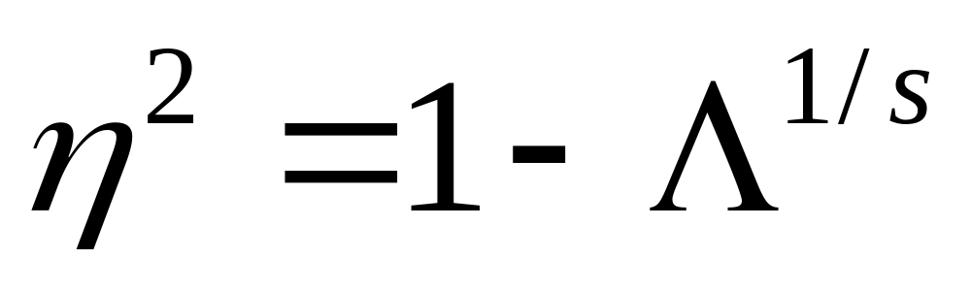
Partial Eta Squared

